Slide 1


MPC Lab – HMC Meeting
Eric Choi, Mark Pustilnik, Hansung Kim, and Francesco Borrelli
7/14/2025

Slide 2
Agenda
Recap
Technical Updates
Sample data analysis
Discussion
Future Roles and Responsibilities
Scheduling Future Meetings

Slide 3
Recap

Slide 4


Project Overview
Objective: Develop and validate a road grade-aware energy consumption estimation model for electric vehicles
Duration: 7 months (June – December 2025)

Slide 5
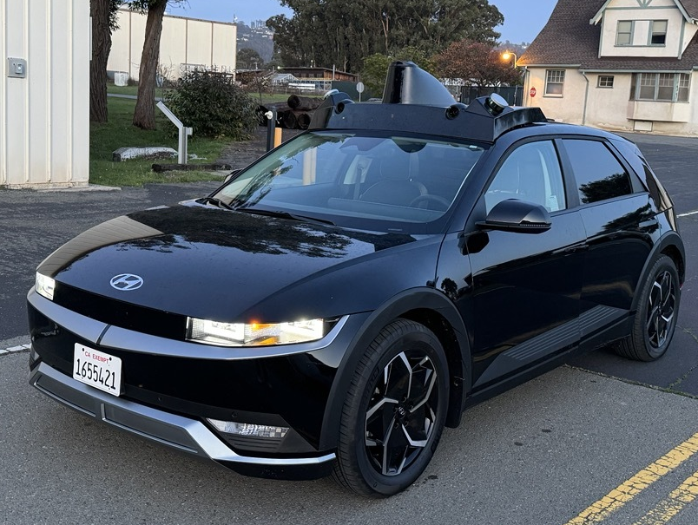
UCB Vehicle Platform
Model: 2023 Hyundai IONIQ 5
Signals:
Vehicle
Speed, wheel torque, etc.
Energy
High/Low voltage battery power, SOC, etc.
IMU
Accel., pitch angles, etc.
GPS
Latitude, Longitude, and Altitude
(optional) Altitude through Google or HERE API

Slide 6
Technical Update

Slide 7
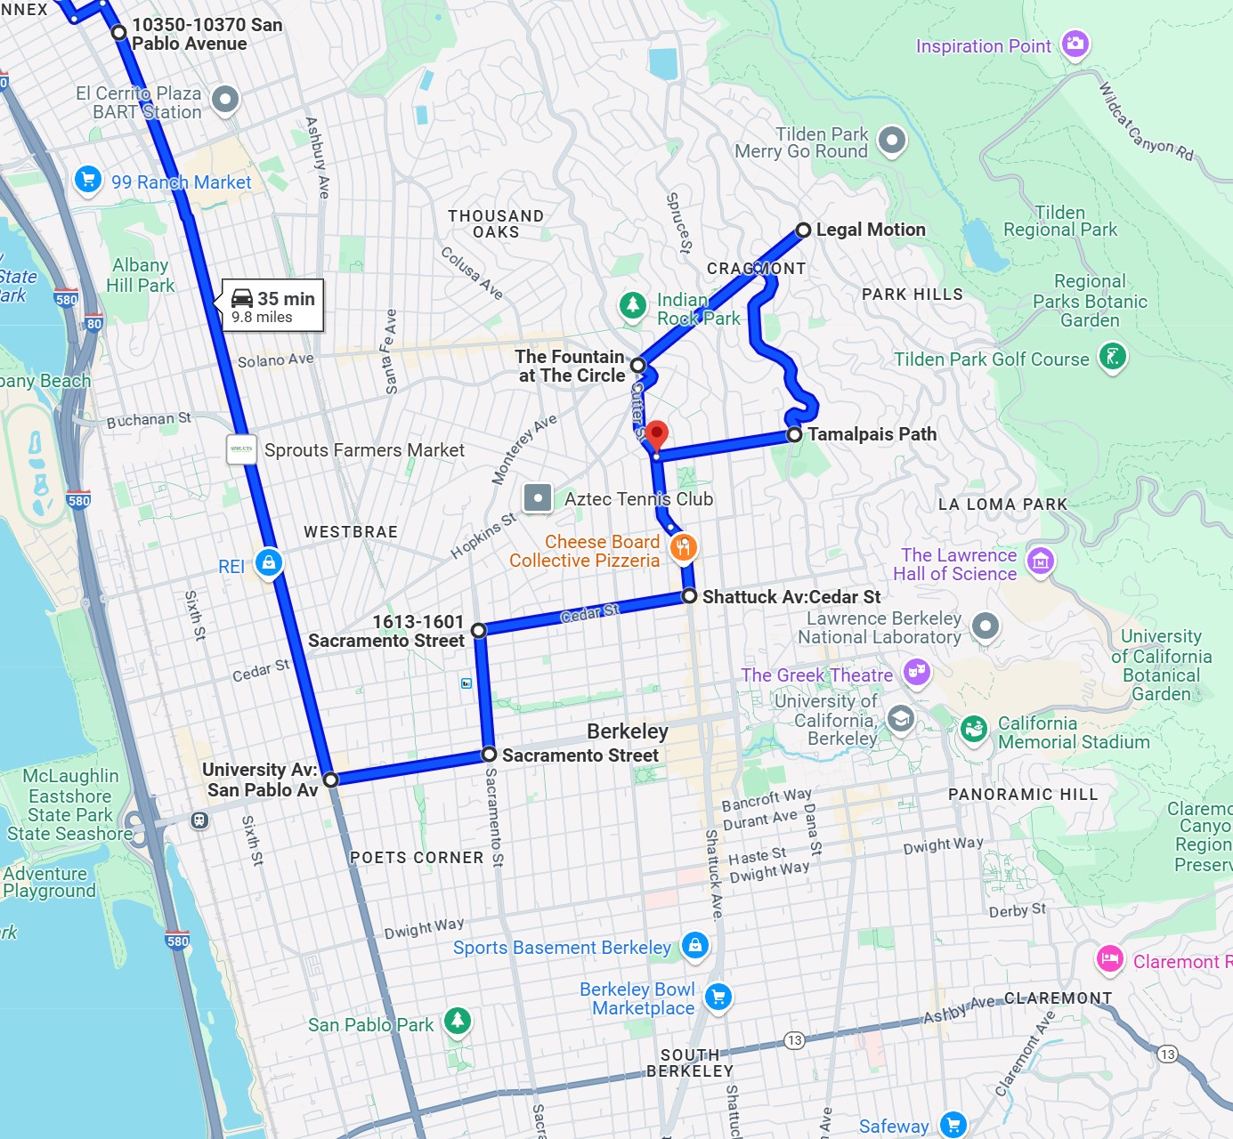
Sample Data Collection
Objective: Collect representative driving data across flat, moderate, and steep road segments to capture diverse road grade effects
Route Selected: Berkeley, California
Signals Evaluated:
Energy
Vehicle data
Road grade

Slide 8
Energy Usage Measurement
In this work, we measure energy consumption using the following high-voltage battery signals:
high-voltage battery current,
high-voltage battery voltage.
Additionally, we record auxiliary power usage (e.g., air conditioning and other onboard systems).

Slide 9
Background: Factors Affecting EV Energy Consumption
Before discussing the impact of road grade on energy consumption, let’s consider the broader factors influencing a vehicle’s energy usage.
Road grade not only affects vehicle measurements, but vehicle behavior itself also plays a significant role in energy consumption.
From UC Berkeley’s previous studies on electric vehicle energy usage, higher driving speeds have been shown to lead to increased energy consumption.
Electric vehicles are less impacted by stop-and-go driving compared to internal combustion engine (ICE) vehicles.

Slide 10
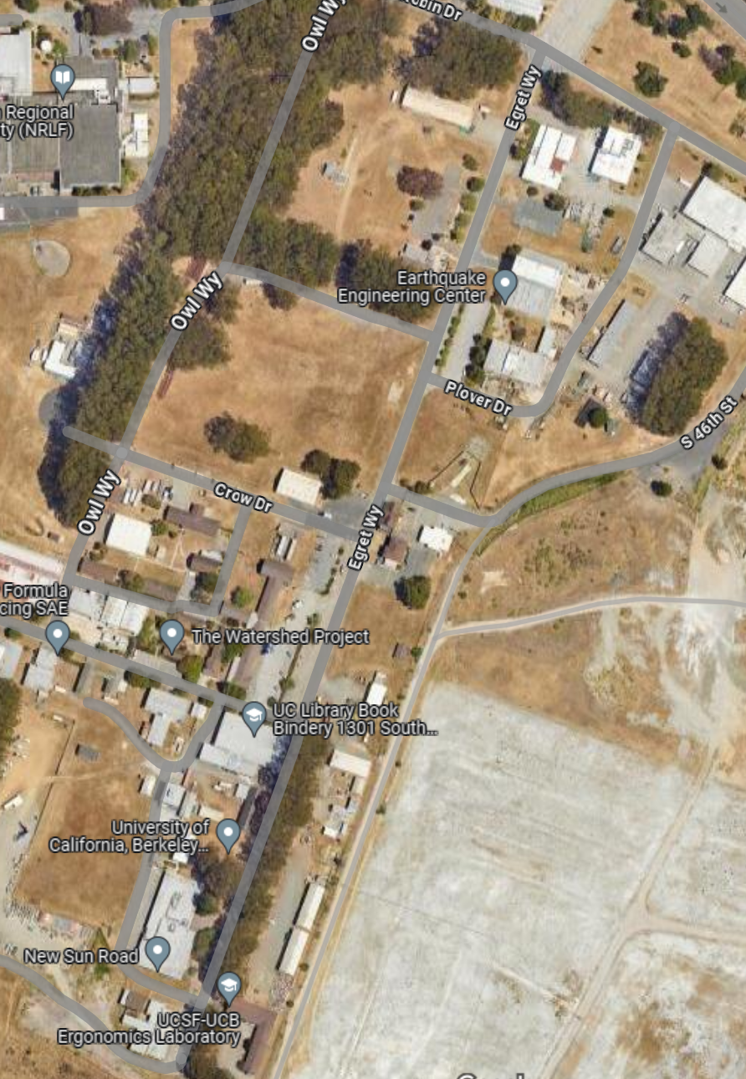
Background: Factors Affecting EV Energy Consumption
START
The vehicle travels in a straight line for approximately 450 meters (0.28 miles).
In each experiment, we vary the vehicle's reference speed.
Instead of using a human driver, we designed a controller to maintain a constant reference speed, consistent acceleration, and deceleration for each run.
Goal: Observe how energy usage varies with different traveling speeds over the same distance.
END

Slide 11


Background: Factors Affecting EV Energy Consumption
The same color corresponds to the same run for the two figures above.
: High Voltage Battery Usage
: High Voltage Battery Usage – Auxiliary Power Usage (Motion Energy)

Slide 12
Background: Factors Affecting EV Energy Consumption
The experiments were repeated with AC usage averaging approximately 440 watts.

Slide 13
Background: Factors Affecting EV Energy Consumption
O: With AC usage
X: Without AC usage
The experiments were repeated without AC usage. As a result, energy consumption decreased by 9.2% on average in experiments without AC usage.

Slide 14
Background: Factors Affecting EV Energy Consumption
Based on this experiment, when comparing the impact of road grade on energy consumption, it is important to account for:
Auxiliary power usage (e.g., air conditioning)
Vehicle speed (travel time)
O: With AC usage
X: Without AC usage
The experiments were repeated without AC usage. As a result, energy consumption decreased by 9.2% on average in experiments without AC usage.

Slide 15
Sample Data Collection
Flat Road
Moderate Road Grade
Steep Road Grade
Total traveled distance: ~750 m
Total travel time: ~100 seconds
Normal Driving Mode
Regen Level 1

Slide 16
Sample Data Collection
Flat Road
Moderate Road Grade
Steep Road Grade

Slide 17
Sample Data Collection
 | Flat | Moderate | Steep
Travel Time [s] | 103 | 103 | 108
Travel Distance [m] | 788 | 785 | 751
Average AC Power [W] | 249 | 182 | 214
Average Pitch [deg] | 2.4 | 5.6 | 9.5
Total Energy Consumption [MJ] | 1.1 | 2.2 | 3.51

Slide 18
Sample Data Collection

Slide 19
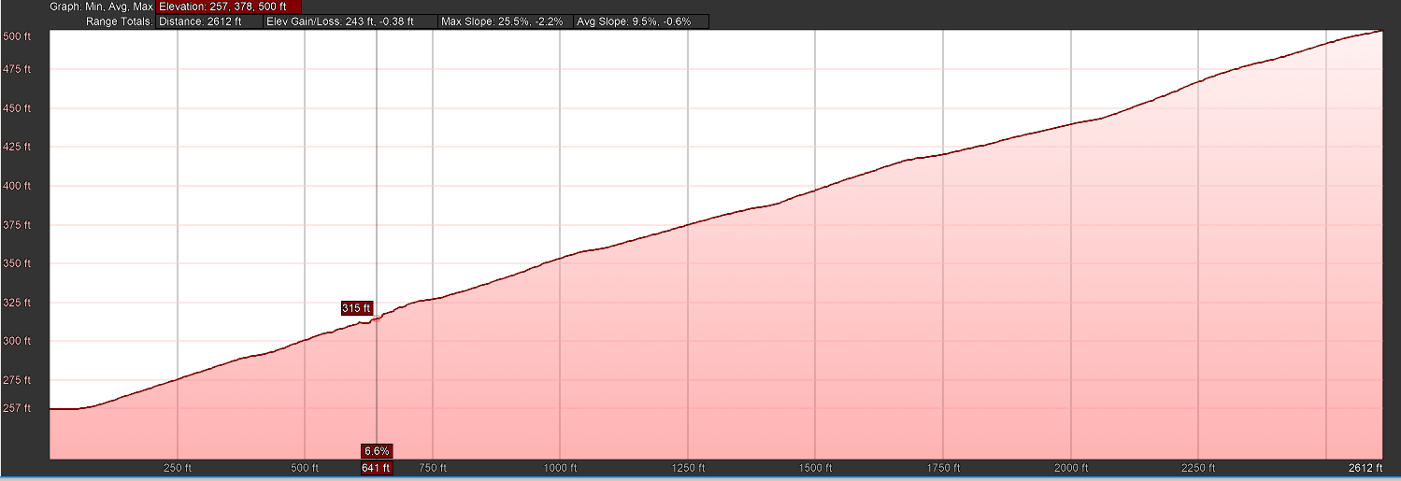
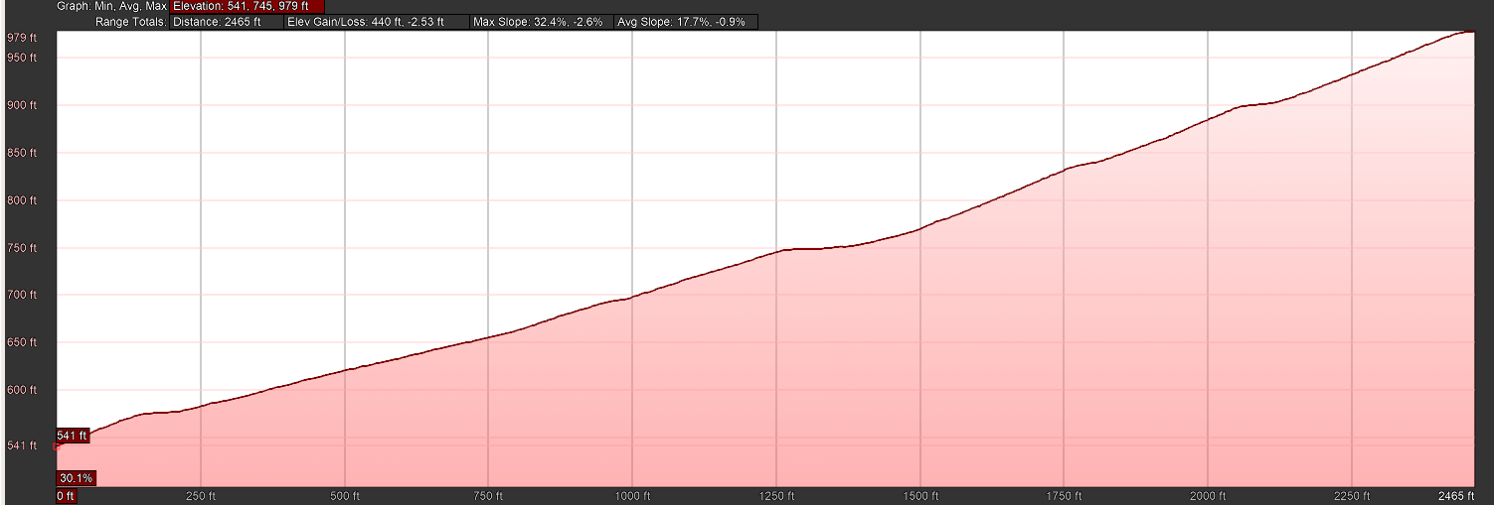
Sample Data Collection
Moderate altitude data:
dGPS: 73 meters
Google Earth Pro: 74 meters
Steep altitude data:
dGPS: 125 meters
Google Earth Pro: 133 meters

Slide 20
Discussion

Slide 21
Discussion
Future Roles and Responsibilities
Scheduling Future Meetings
Files/code share environment (Box)

